Slide 1
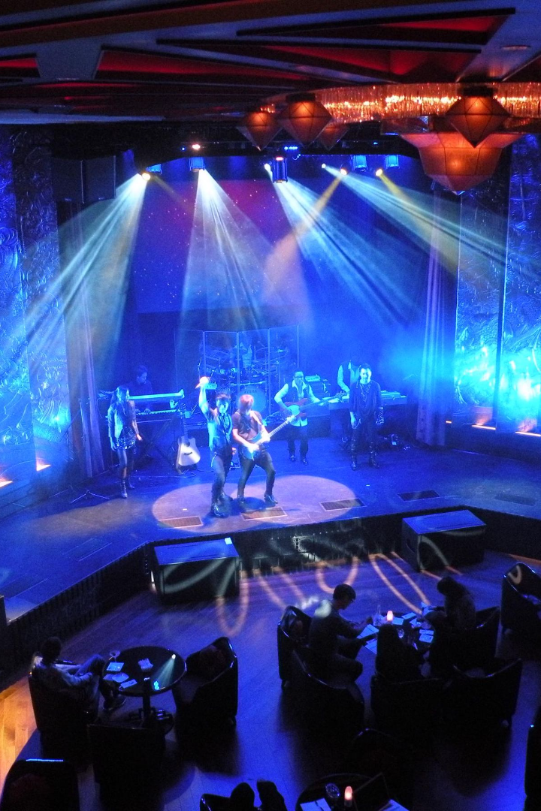

Unlocking Opportunities for Success: A Comprehensive Analysis of DICE Events Company

Slide 2
Purpose and Scope of the Presentation:
The purpose of this presentation is to analyze the financial and operational performance of DICE a leading live events company in United States and provide strategic insights to enhance its future success. The scope of this presentation encompasses:
Current Business Assessment:
Evaluating profitability trends, occupancy rates and attendee metrics.
Analyzing the impact of expansion strategies and venue costs on financial performance.
Data-Driven Insights:
Uncovering key drivers influencing business outcomes.
Presenting actionable recommendations for optimizing profitability and market reach.
Utilizing Advanced Technologies:
Exploring the potential of AI and machine learning for personalized event planning.
Enhancing audience engagement through tailored event experiences.
Future Strategies:
Suggesting approaches to reengage audiences and stabilize profitability.
Identifying opportunities for strategic expansion and market selection.
Presentation Goals:
Provide a comprehensive overview of the company's current performance.
Deliver actionable insights to guide decision-making and drive positive change.

Slide 3
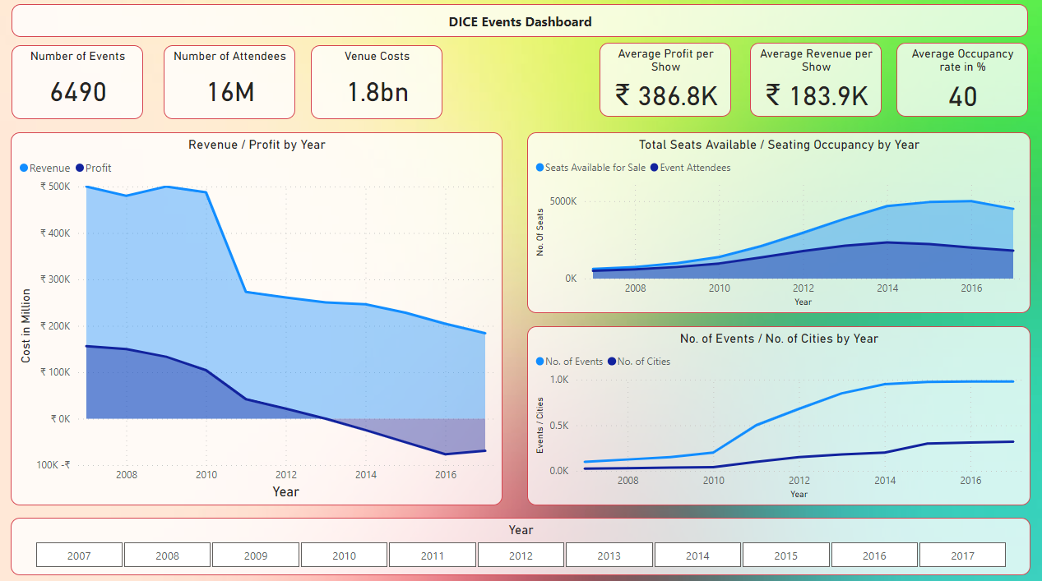
Trends in Revenue and Profitability
Tool Used: Power BI
Feel free to check out the Power BI dashboard which gives you the opportunity to explore and interact with the live data visualization on your own system. LINK

Slide 4



Data Driven Insights
Profitability Trend: We experienced profitable years until 2012, after which profitability declined. Understanding the factors behind this shift is critical for future success.
Occupancy Rate Impact: The initial 80% occupancy rate gradually declined to 40% by 2017. Addressing this decline is essential for maintaining audience engagement and revenue.
Attendees vs Seating: As seating capacity increased, the number of attendees decreased. Balancing capacity with demand is vital to optimize event attendance and revenue.
Expansion Challenges: Expanding to more cities and events led to financial losses. Careful selection of cities and event frequency is necessary to ensure profitability.
Venue Cost Management: Rising venue costs affected profitability. Negotiating longer-term agreements with landlords can help stabilize costs and improve financial outlook.
Strategic City Selection: Focusing on key cities that align with our target audience and market potential is more effective than being present in all cities.
Quality Over Quantity: Shifting focus from frequent events to high-quality, occasional events can create anticipation and excitement, potentially leading to increased attendance and revenue.

Slide 5

Current Business Performance
1
Occupancy Rate and Attendee Engagement:
Declining occupancy rates from 80% in 2007 to 40% in 2017 indicate a need to
re-engage audiences.
Balancing seating capacity with demand is crucial to optimize attendee turnout and
revenue generation.
2
Expansion Strategy Impact:
Expanding to more cities and events resulted in financial losses.
Careful selection of cities and events is essential to ensure profitability and strategic growth.
3
Venue Costs and Profitability:
Rising venue costs impacted overall profitability.
Exploring longer-term agreements with landlords can stabilize costs and improve financial performance.
4
Market Selection Strategy:
Prioritizing key cities that align with our target audience and market potential can enhance
market penetration and revenue.
5
Profitability Trend:
Profitable years until 2013 were followed by declining profitability.
Identifying reasons for this trend is critical for informed decision-making.

Slide 6
Reducing Variable Costs
Actor Training
Gamification
We can invest in training programs and workshops to improve the skills of our actors, reducing the need to hire additional actors.
We can create incentive programs that encourage our actors to be more productive and efficient.
Venue Partnerships
Seasonal Hires
We can partner with venues to negotiate long-term contracts, resulting in lower rent and more predictable costs.
We can hire seasonal actors who will work only during peak seasons, reducing our need for year-round full-time actors.

Slide 7

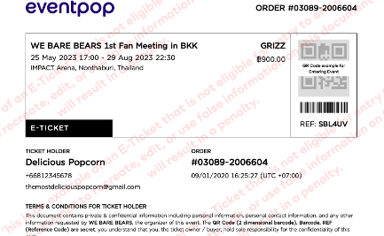

Exploring New Revenue Streams
Corporate Events
Online Streaming Services
Merchandise Sales
We can partner with companies to host private shows for their clients, boosting revenue and expanding our reach.
We can create and sell merchandise such as t-shirts and mugs to supplement our ticket sales.
We can offer a virtual experience to reach audiences who cannot make it to the live event.

Slide 8
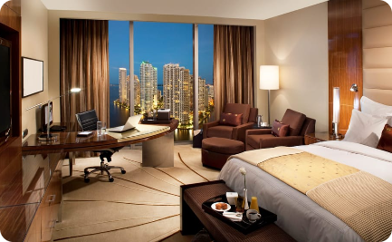
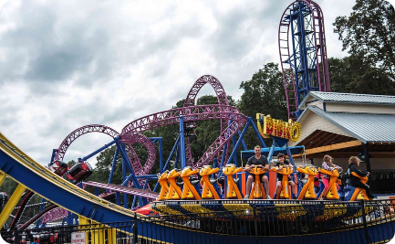
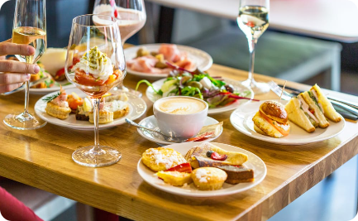
Potential Partnerships
Hotel Chain
Theme Parks
Food and Beverage Chains
We can partner with hotel chains to offer packages that include hotel accommodations and tickets to our shows.
We can partner with theme parks to create live shows that fit their themes, providing a unique experience to their visitors.
We can partner with food and beverage chains to offer discounts to their customers, provided they also purchase tickets to our shows.

Slide 9
Recommendations and Next Steps
Utilize machine learning and AI algorithms to analyze user preferences.
Evaluate historical data and interactions to understand audience interests.
Develop personalized event recommendations for each city based on insights.
Strategic Expansion and Event Planning:
Prioritize quality over quantity in city and event expansion.
Plan events strategically for optimal revenue and attendee engagement.
Venue Cost Management for Stability:
Negotiate longer-term venue agreements to stabilize costs.
Ensure cost predictability for improved profitability.
Enhance Event Experience and Market Penetration:
Focus on high-quality, occasional events to create anticipation.
Invest in marketing and engagement for larger audience reach.
Monitor and Analyze Profitability Trends:
Continuously track profitability trends and adjust strategies.
Regularly review metrics for emerging insights.
Collaboration and Partnerships:
Forge collaborations with artists, performers, and sponsors.
Leverage partnerships for unique event experiences and revenue growth.
Our recommendations include exploring new revenue streams, expanding our show offerings, reducing variable costs through training, gamification and venue partnerships and forming partnerships with hotels, theme parks and food and beverage chains. Our next steps include analyzing data to optimize our financial model, creating a detailed plan for rolling out new offerings, identifying efficient training programs and initiating the talk with potential partners.

Slide 10
Thank You

